Slide 1
TCP
TCP lies between the application layer and the network layer, and serves as the intermediary between the application programs and the network operations.
Process to process communication

Slide 2
Introduction
TCP provides a
connection oriented
reliable
byte stream service
The term connection oriented means the two application using TCP must establish a TCP Connection with each other before exchange data.

Slide 3
TCP services
There are exactly two end points communication with each other on TCP connection.
Does not support multicasting and broad casting .
Unit of information passed by TCP to IP is called a segment.
When TCP sends a segment it maintains a timer ,waiting for the other end to acknowledge.

Slide 4
TCP Service cont ..
If an acknowledgement isn’t received in time ,the segment is retransmitted .
TCP also provides flow control
A TCP connection is a byte stream not a message stream .

Slide 5
TCP Features
Numbering System:
The TCP software keeps track of the segments being transmitted or received.
There are two fields called the sequence number and the acknowledgment number.
Full-Duplex Communication
TCP offers full-duplex service, in which data can flow in both directions at the same time.
Each TCP then has a sending and receiving buffer, and segments move in both directions.

Slide 6
Flow Control
The receiver of the data controls the amount of data that are to be sent by the sender. This is done to prevent the receiver from being overwhelmed with data.
Error Control
To provide reliable service, TCP implements an error control mechanism.
Congestion Control
The amount of data sent by a sender is not only controlled by the receiver, but by the level of congestion in the network.

Slide 7
TCP Congestion
TCP uses a form of end flow control.
Both the sender and receiver agree on a common window size for packet flow.
Window size varies according to the condition of traffic in the network to avoid congestion.
Three Congestion control methods
Additive increase Multiple decrease
Slow Start
Fast Retransmit

Slide 8
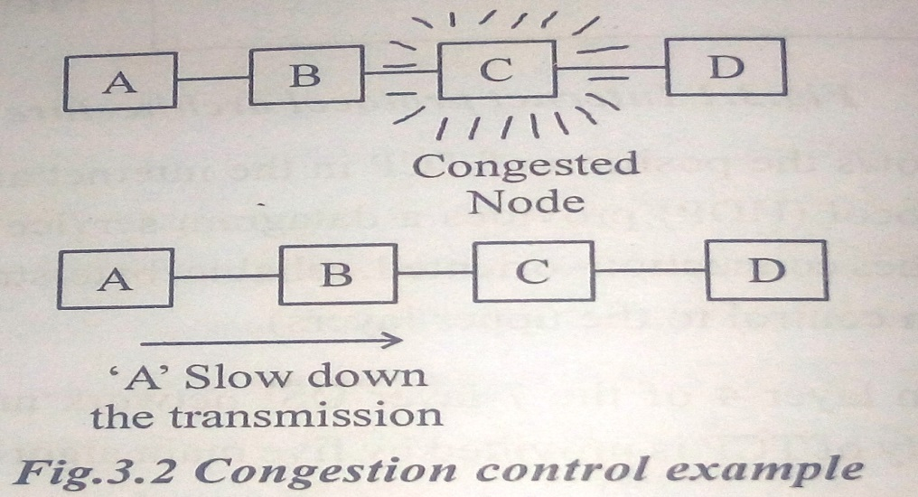
Congestion Control
TCP is designed for fixed networks, with fixed end systems
Generally, Data transmission takes place using network adapters, fiber optics, copper wires, special hardware for routers etc
This hardware typically works without introducing transmission errors
If the software is mature enough, it will not drop packets or flip bits, so if a packet on its way from a sender to a receiver is lost in a fixed network, it is not because of hardware or software errors.
The probable reason for a packet loss in a fixed network is a temporary overload some point in the transmission path, i.e., a state of congestion at a node.

Slide 9
Even if a highly designed network, there is possibility for congestion.
In that time, the network takes decision to drop some packets.
When a dropped packet is lost, the receiver notices a gap in the packet stream and do not intimate this lost to sender, instead it will acknowledge continuously upto the missing packet
Later, sender will notice the missing acknowledgement for the lost packet and assume that the packet is lost due to congestion
To reduce the congestion, TCP slows down the transmission consistently. All other TCP connections experiencing the same congestion do exactly the same procedure so that congestion is controlled

Slide 10
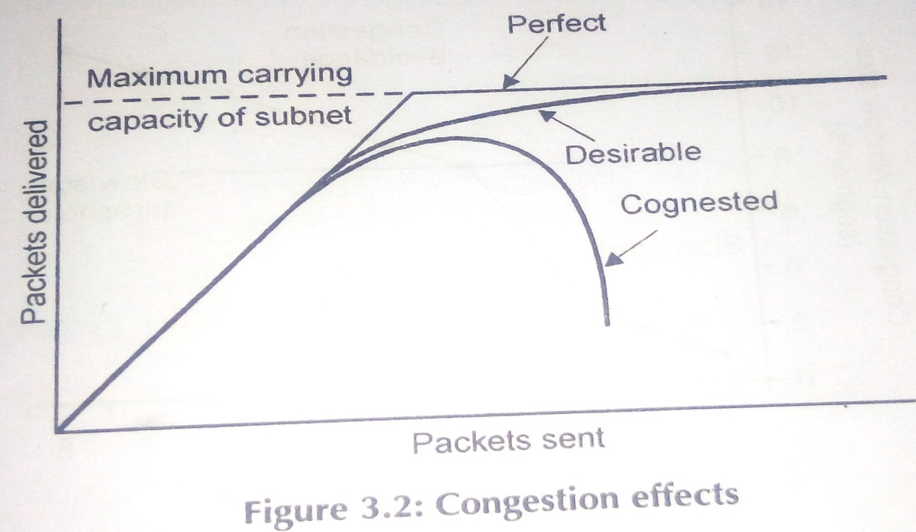
Congestion Effects
Packet delay
Packet loss
Degraded performance
Most effective way to control congestion is to reduce the load that the transport layer is placing on the network
Factors that cause congestion
Packet arrival rate exceeds the outgoing link capacity
Insufficient memory to store arriving packets
Bursty traffic
Slow processor

Slide 11
Congestion control techniques
Congestion control is concerned with efficiently using a network at high load
Several techniques can be employed. These include
Warning bit
Choke packets
Load shedding
Random early discard
Traffic shaping
The first 3 deal with congestion detection and recovery
The last 2 deal with congestion avoidance

Slide 12
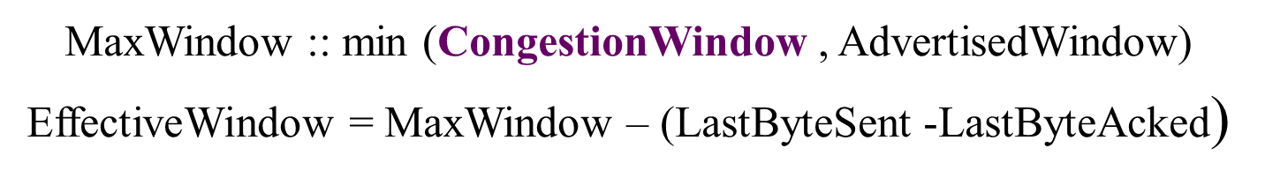
AIMD
Additive Increase / Multiplicative Decrease
AIMD perform a slow increase in the congestion window size when the congestion in the network decreases and fast drop in the window size when congestion increases.

Slide 13
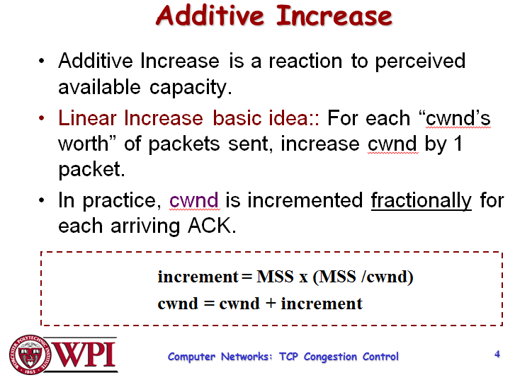

Slide 14
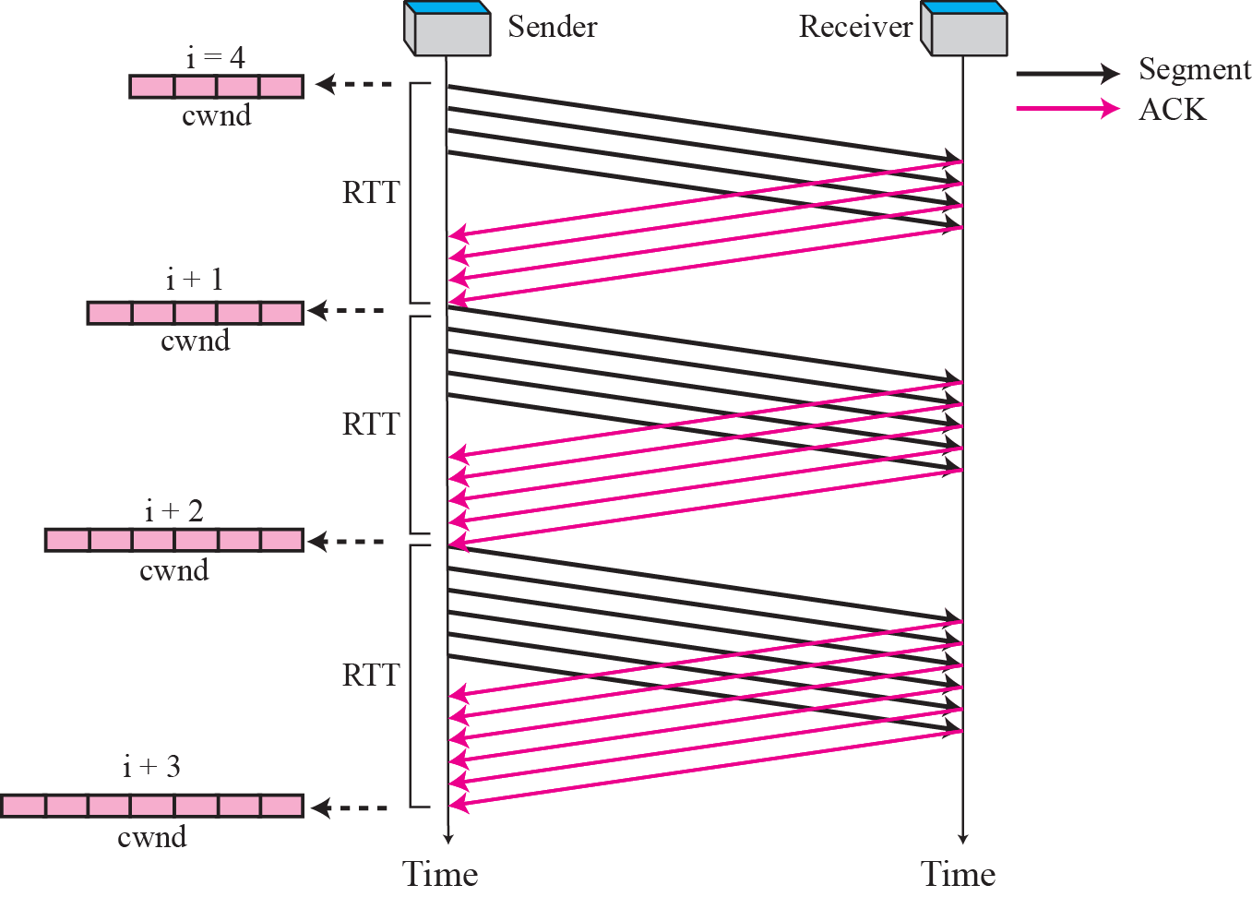
Figure 35 Congestion avoidance, additive increase

Slide 15
Slow Start
The behavior TCP shows after the detection of congestion is called slow start
Slow start, a requirement for TCP software implementations is a mechanism used by the sender to control the transmission rate, otherwise known as sender-based flow control
The sender always calculates a congestion window for a receiver. The start size of the congestion window is one segment (TCP packet).
The sender sends one packet and waits for acknowledgement. If this acknowledgement arrives, the sender increases the congestion window by one, now sending two packets
After successful transmission of these two segments and acknowledgements completes, the window is increased to four segments. Then eight segments, then sixteen segments and so on.
This method doubles the congestion window every time the acknowledgements come back and takes one round trip time (RTT). This is called the exponential growth of the congestion window in the slow start mechanism

Slide 16
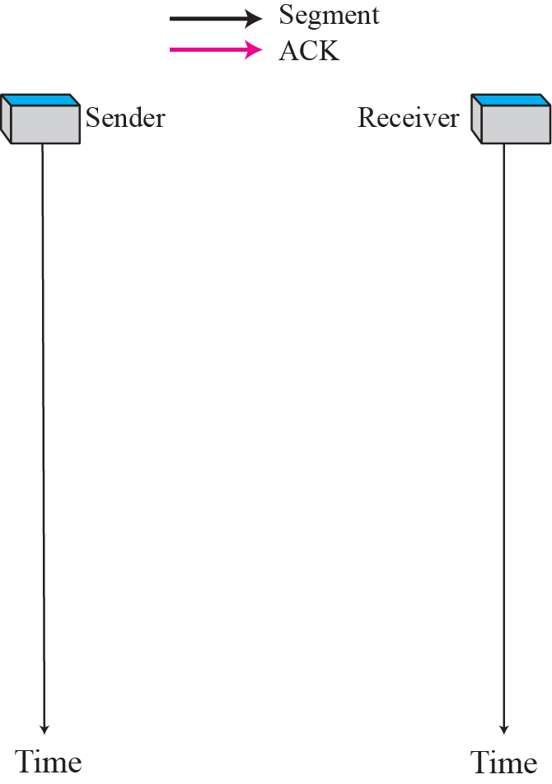
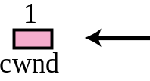
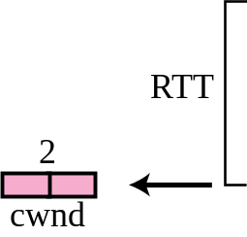
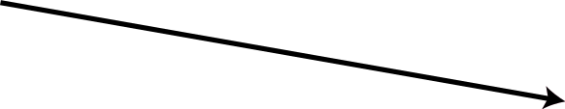

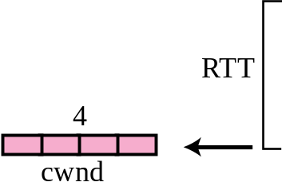
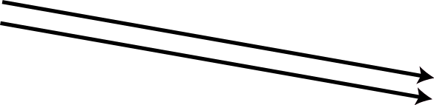
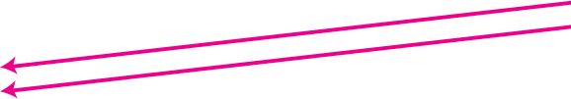
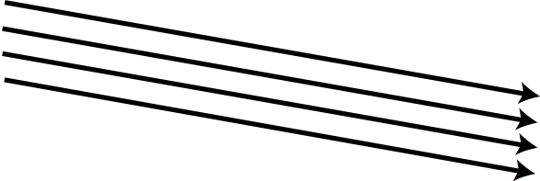
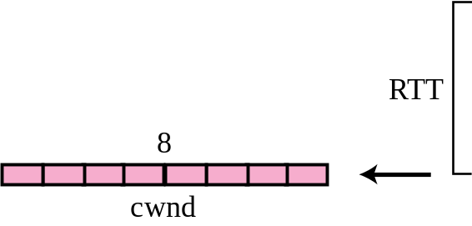
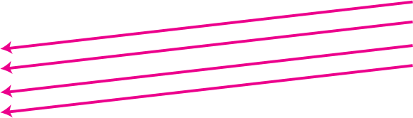
The exponential growth stops at the congestion threshold.
When congestion window reaches the congestion threshold, further increase of the transmission rate is only linear by adding 1 to the congestion window each time the acknowledgements come back.
Figure 34 Slow start,
exponential increase

Slide 17
Fast retransmit/fast recovery
Fast retransmit and fast recovery are two important mechanisms to reduce the congestion threshold.
In a TCP, a receiver sends acknowledgements only if it receives any packets from the sender.
Whenever there is any gap in the packet stream, it may not always mean that the network is congested but also sometimes loss of some packet due to transmission error.
In such cases sender retransmit the missing packet before time out.
This process is called as Fast retransmit method
The receipt of acknowledgements shows that there is no congestion to justify a slow start.
The sender can continue with the current congestion window.
The sender performs a fast recovery from the packet loss. This mechanism can improve the efficiency of TCP dramatically

Slide 18
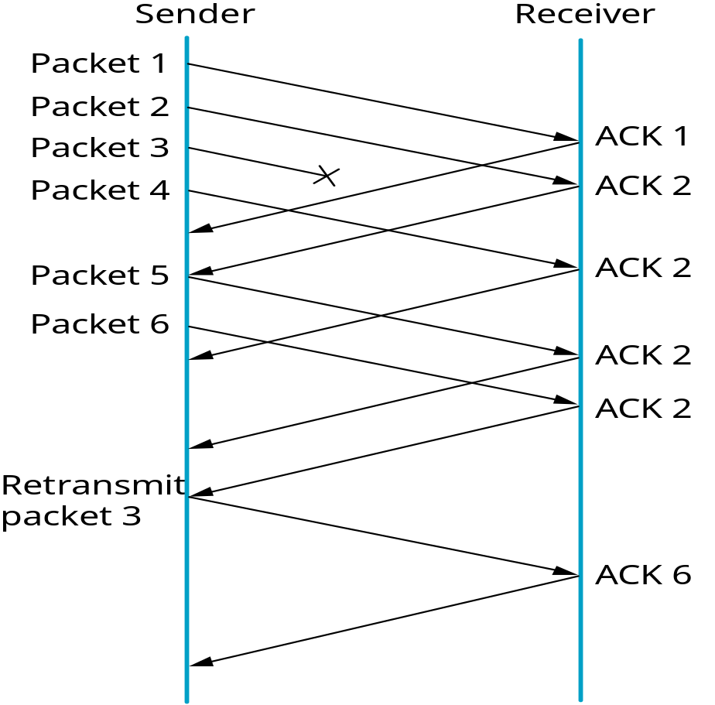
Advantages:
Simple approach
Only minor changes in the mobile host’s software already result in a performance increase
No foreign agent or correspondent host has to be changed
Disadvantages:
Insufficient isolation of packet losses
Mixed layers, not transparent

